Slide 1


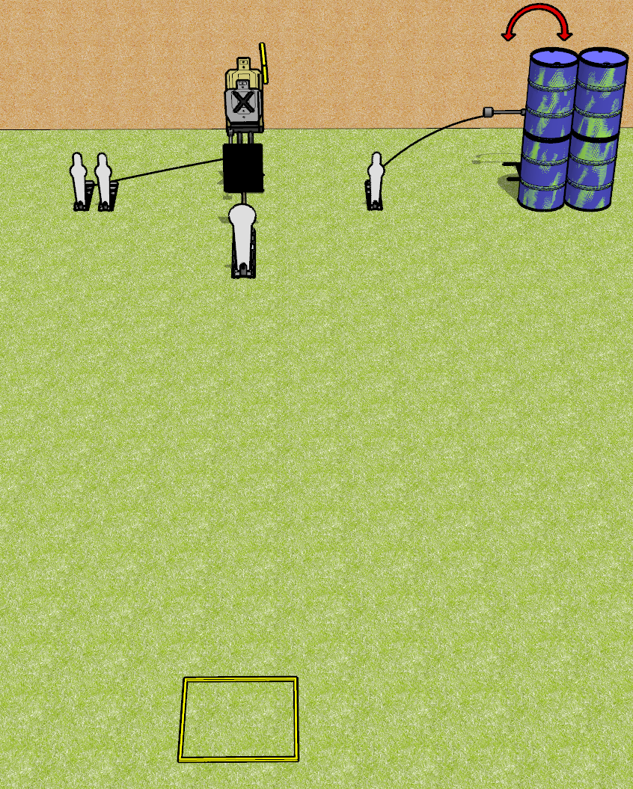
 | Dothan Gun Club – USPSA Match Don’t Overthink It Course Designer : Drew Coleman
Round Count 8 rounds 2 USPSA 1 colt popper, 3 mini poppers
Equipment List Max trap + activator, swinger + activator Shooting box 18x24 plate + stand to protect the max trap Make sure the shooting box is centered on the max trap

Slide 2
Don’t Overthink It
Written Stage Briefing
Don’t Overthink It is an 8 round, 40 point, Comstock speed shoot. There are 2 USPSA targets, 1 colt popper, and 3 mini poppers. The best 2 hits on paper will score, and steel must fall to score. The start signal is audible.
The max trap is activated by either of the leftmost mini poppers and remains visible at rest. The swinger is activated by the right mini popper and remains visible at rest. Please check the activators prior to walkthrough and set them the same way every time.
Handgun start position is in shooting box, wrists below belt. Handgun is loaded and holstered.
PCC start position is in shooting box, stock on belt. Carbine is loaded, held with both hands, safety on.
On start signal engage targets as they become available from within the shooting area.

Slide 3
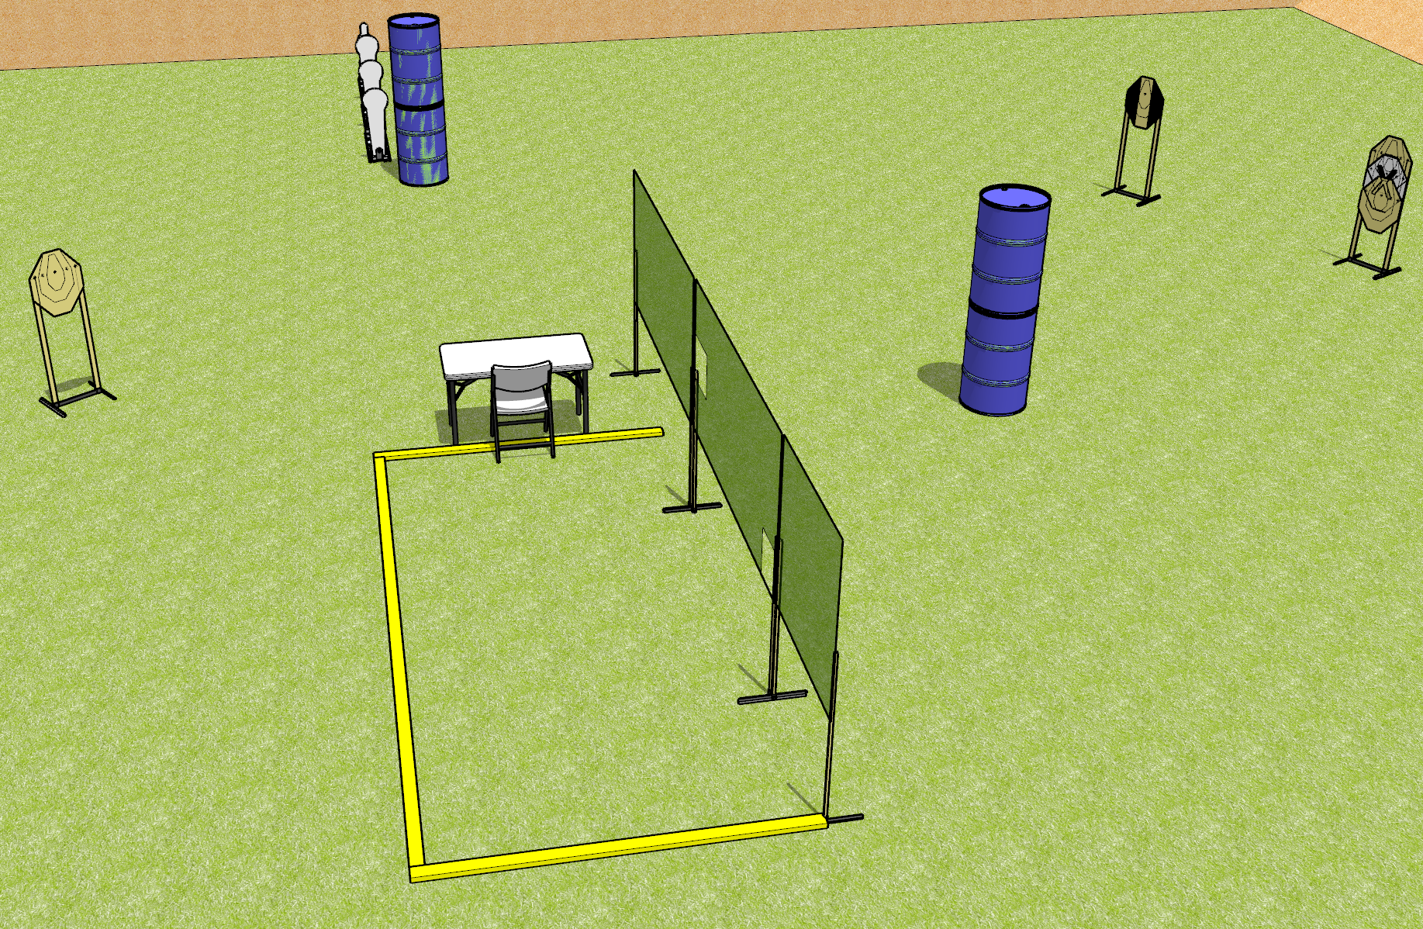
 | Dothan Gun Club – USPSA Match Have a Seat Over There Course Designer : Drew Coleman
Round Count 12 rounds 4 ISPC 3 colt poppers, 1 mini
Equipment List 4 wall feet Use 4 8’ fault lines 1 tuxedo

Slide 4
Have a Seat Over There
Written Stage Briefing
Have a Seat Over There is a 12 round, 60 point, Comstock course of fire. There are 4 IPSC targets, 3 colt poppers, and 1 mini popper. The best 2 hits on paper will score and steel must fall to score. The start signal is audible.
Start position is seated in chair, back against chair back, hands on knees. Firearm is unloaded and unpropped on the table. All magazines to be used on stage must also be on table.
Do not have to place gun or mags on marks, if table has marks.
On start signal, engage targets as they become available from within the shooting area.

Slide 5
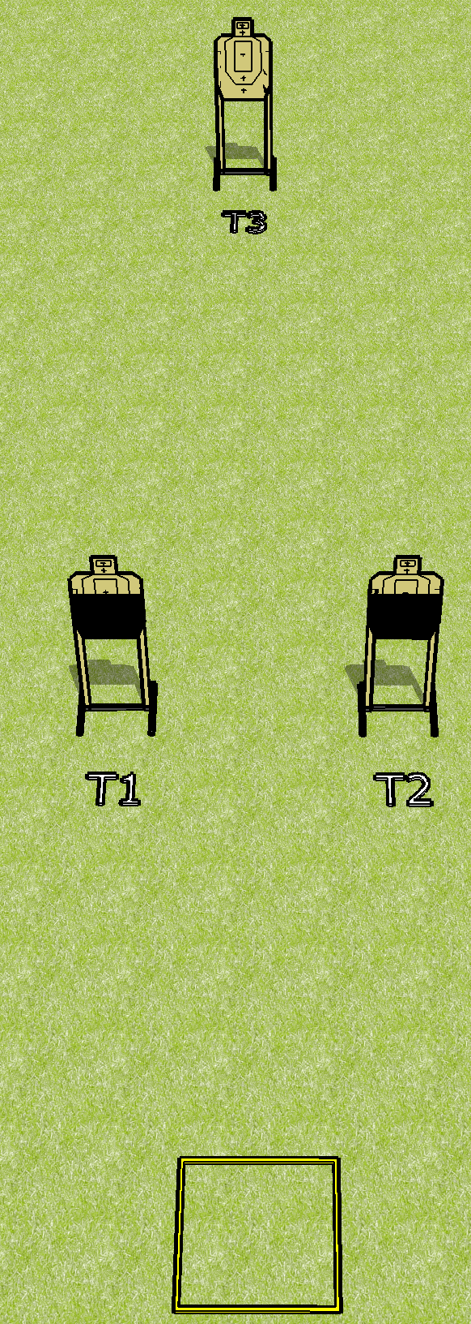
 | Dothan Gun Club – USPSA Match Really Now, Can You Count? Course Designer : Drew Coleman
Round Count 18 rounds 3 USPSA
Equipment List Shooting box

Slide 6
Really Now, Can You Count?
Written Stage Briefing
Really Now, Can You Count is an 18 round, 90 point, Virginia Count standard exercise. There are 3 USPSA targets. The best 6 hits on paper wills score. The start signal is audible.
Handgun start position is in shooting box, wrists below belt. Handgun is loaded and holstered.
PCC start position is in shooting box. Loaded carbine is held with both hands, stock on belt, safety on.
String 1: Engage T1 and T2 in any order with only 3 rounds each, perform a mandatory reload and then engage T3 with only 2 rounds.
String 2: Engage T3 with only 4 rounds, perform a mandatory reload and then engage T1 and T2 in any order with only 3 rounds each STRONG HAND ONLY.

Slide 7
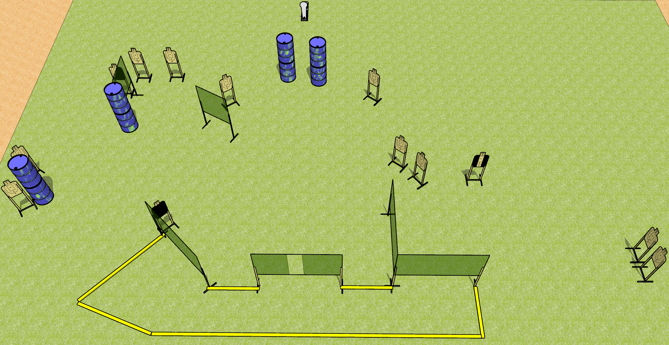
 | Dothan Gun Club – USPSA Match Scoot Scoot Scoot Course Designer : Drew Coleman
Round Count 27 rounds 13 USPSA 1 colt popper
Equipment List 3 medium fault lines 11 wall feet 1 headshot, 1 right diagonal HC, 1 tuxedo

Slide 8
Scoot Scoot Scoot
Written Stage Briefing
Scoot Scoot Scoot is a 27 round, 135 point, Comstock course of fire. There are 13 USPSA targets and 1 colt popper. The best 2 hits on paper will score, and steel must fall to score. The start signal is audible.
Handgun start position is both feet touching any fault line, wrists below belt. Handgun is loaded and holstered.
PCC start position is both feet touching any fault line, stock on belt. Loaded carbine is held with both hands, safety on.
On start signal, engage targets as they become available from within the shooting area.

Slide 9
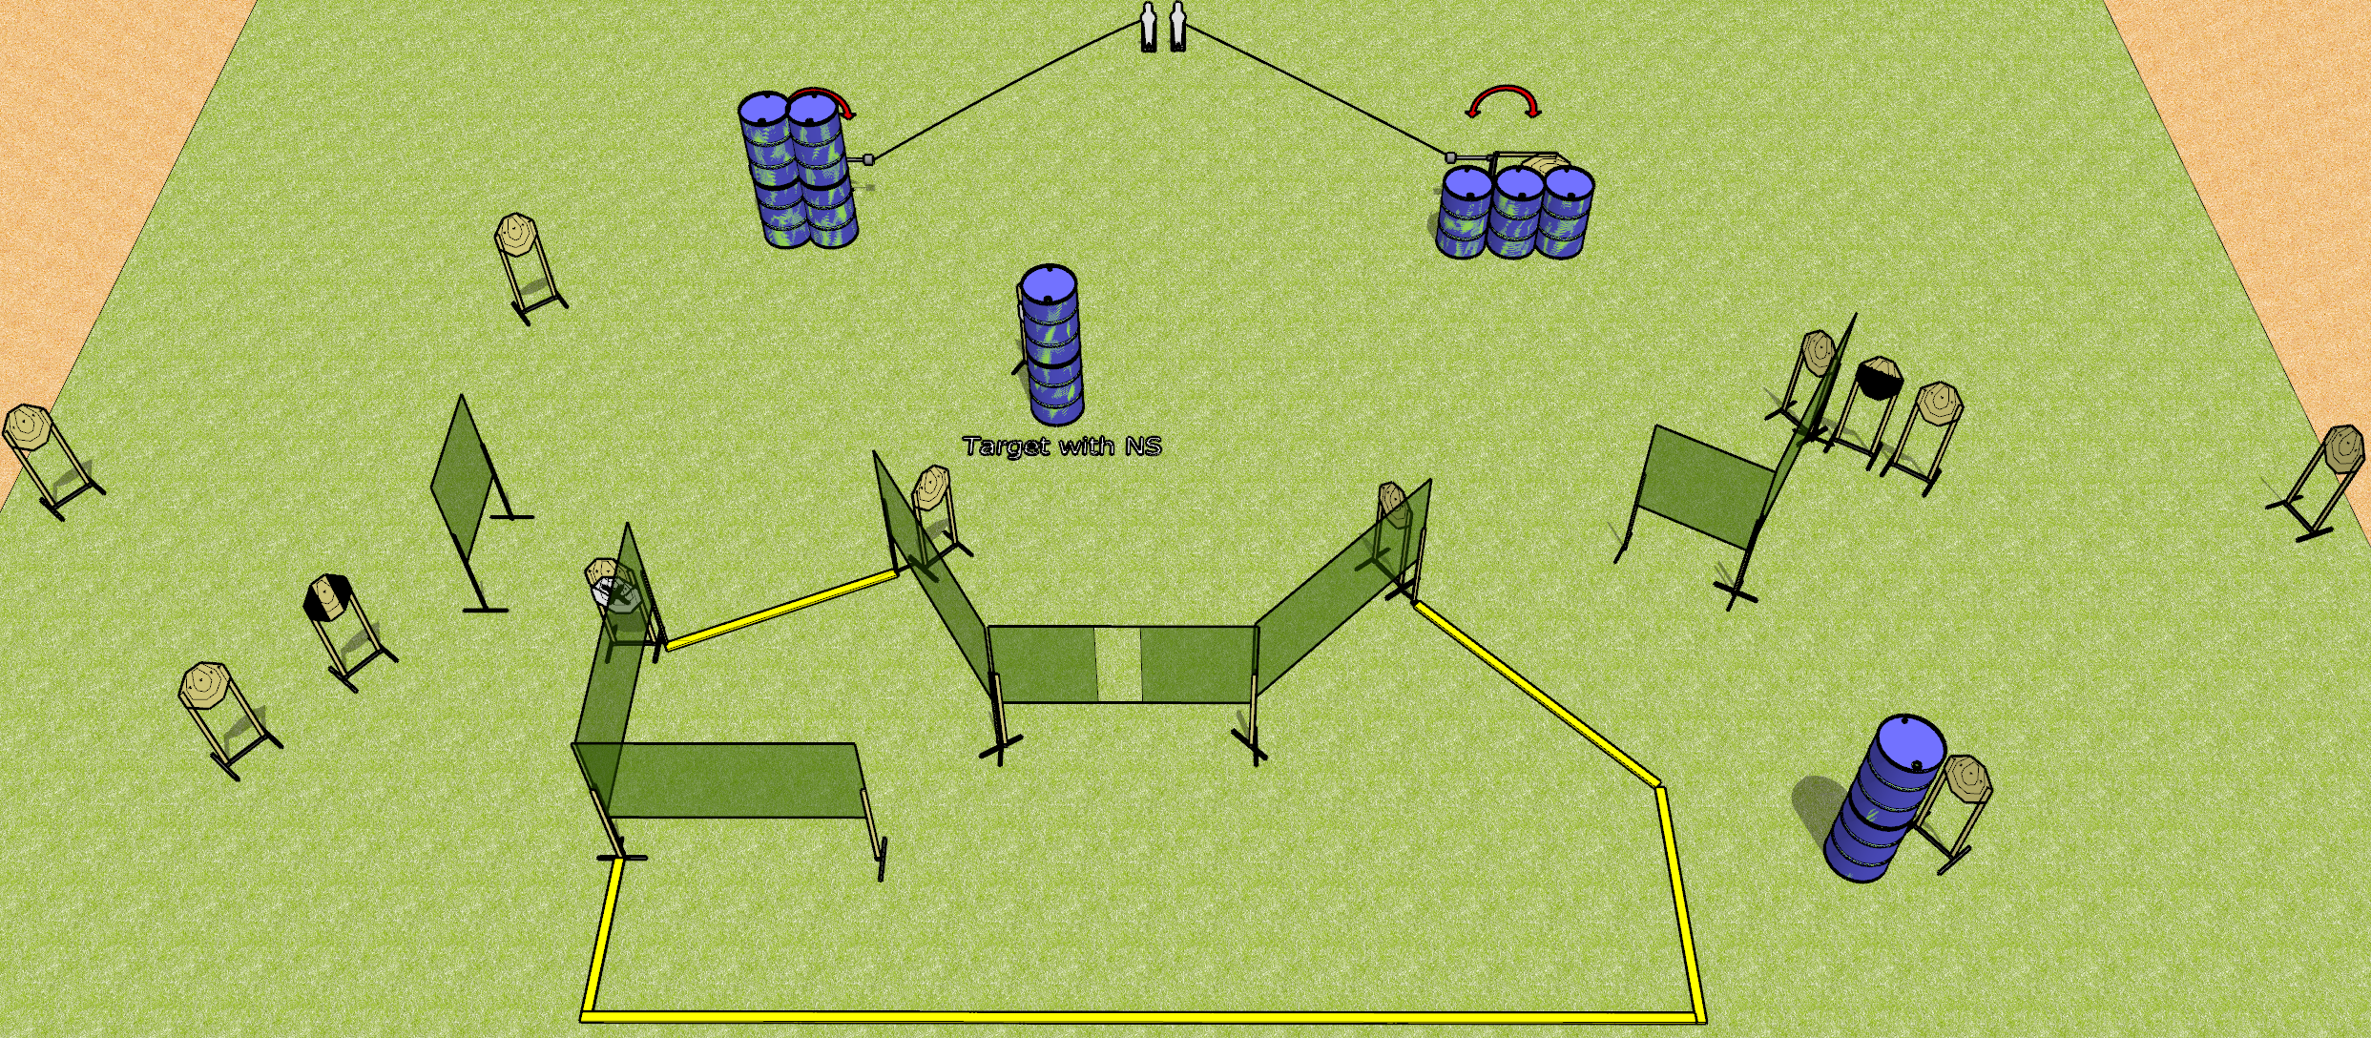
 | Dothan Gun Club – USPSA Match Full Send Course Designer : Drew Coleman
Round Count 30 rounds 14 ISPC 2 mini poppers
Equipment List 14 wall feet 2-3 medium wall feet Rear of shooting area should be 30’ across 1 tuxedo, 1 50%

Slide 10
Full Send
Written Stage Briefing
Full Send is a 30 round, 150 point, Comstock course of fire. There are 14 IPSC targets and 2 mini poppers. The best 2 hits on paper will score, and steel must fall to score. The start signal is audible.
The left swinger is activated by the left popper and the right swinger is activated by the right popper. Both swingers are visible at rest and must be activated before being engaged. Please check the activators prior to walkthrough and set them the same way every time.
Handgun start position is anywhere inside the shooting area, wrists below belt. Handgun is loaded and holstered.
PCC start position is anywhere inside the shooting area, stock on belt. Loaded carbine is held with both hands, safety on.
On start signal engage targets as they become available from within the shooting area.

Slide 11
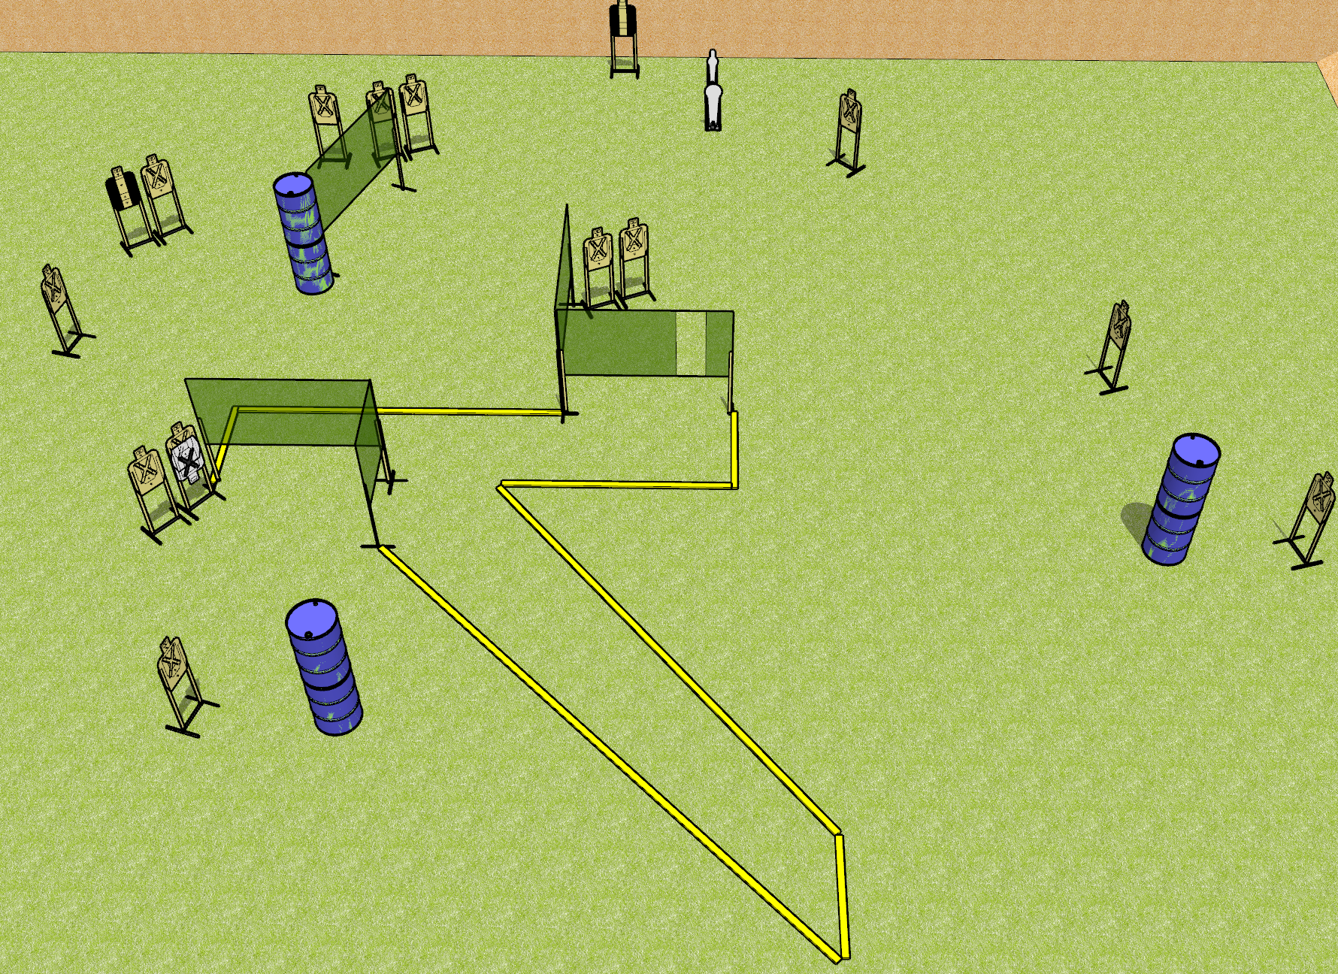
 | Dothan Gun Club – USPSA Match Nom Nom Course Designer : Drew Coleman
Round Count 32 Rounds 15 USPSA 1 mini, 1 colt popper
Equipment List 3 medium fault lines 3 8’ fault lines 8 wall feet 2 tuxedos

Slide 12
Nom Nom
Written Stage Briefing
Nom Nom is a 32 round, 160 point, Comstock course of fire. There are 15 USPSA targets, 1 colt popper, and 1 mini popper. The best 2 hits on paper will score, and steel must fall to score. The start signal is audible.
Handgun start position is anywhere inside the shooting area, wrists below belt. Handgun is loaded and holstered.
PCC start position is anywhere inside the shooting area, stock on belt. Carbine is loaded, held with both hands, safety on.
On start signal, engage targets as they become available from within the shooting area.

